Slide 1

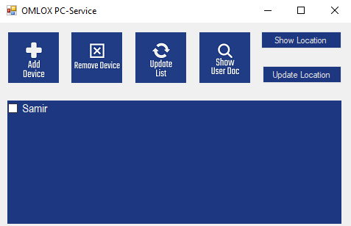
Omlox als PC-Dienst
Omlox als Standortverwaltung für den Windows PC
Mit uns schafft es Ihr Unternehmen hoch hinaus.

Slide 2



Das Team
Juliette Hild
Julia Bai
Marcel König
Gründerin und CEO inf10192@lehre.dhbw-Stuttgart.de Matr.: 6897684
Seniorpartner inf20165@lehre.dhbw-Stuttgart.de Matr.: 209086
Vertriebsmanager inf20107@lehre.dhbw-Stuttgart.de Matr.: 7203551

Slide 3

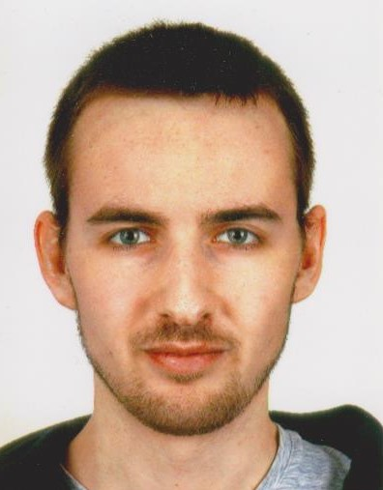

Das Team
Samir Ahmetovic
Aaron Weis
Aaron Kupries
Eric Höfert
Entwickler inf20101@lehre.dhbw-Stuttgart.de Matr.: 6948836
Entwickler inf20169@lehre.dhbw-Stuttgart.de Matr.: 9418588
Tester inf20160@lehre.dhbw-Stuttgart.de Matr.: 9998294
Systemarchitekt
inf20015@lehre.dhbw-stuttgart.de Matr.: 1913329

Slide 4

Omlox als PC-Dienst
Projektplanung
Juliette Hild

Slide 5
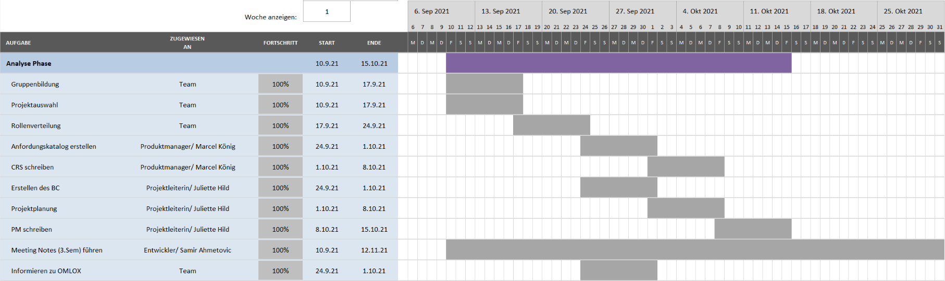
GANTT-Chart

Slide 6
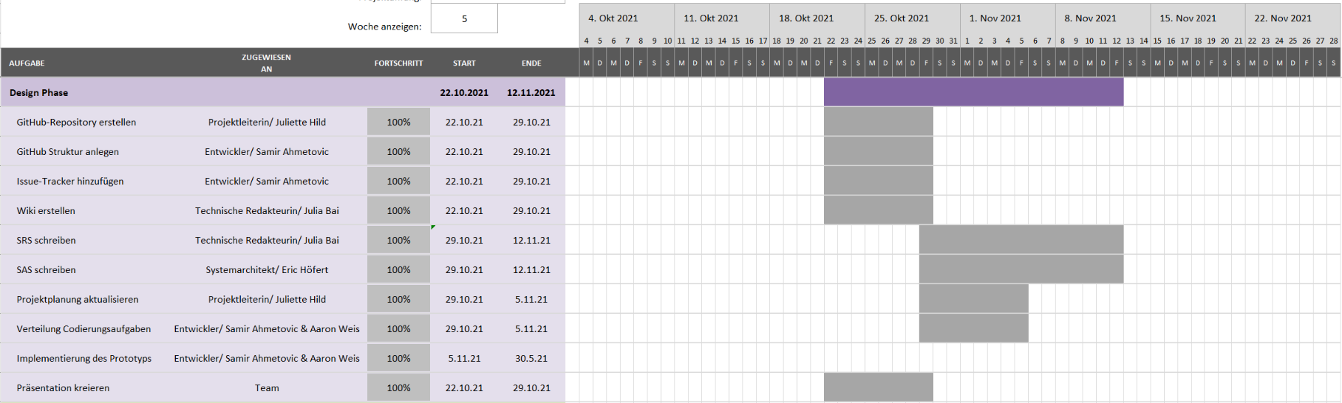
GANTT-Chart

Slide 7
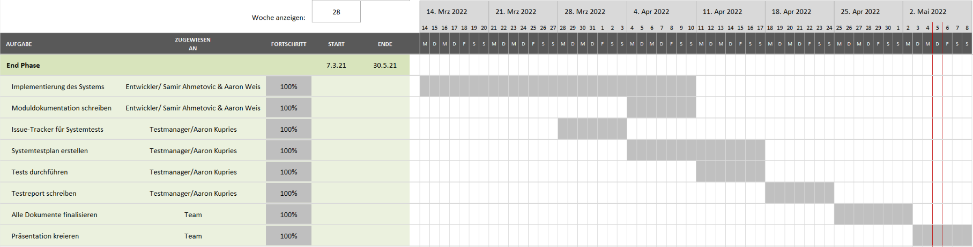
GANTT-Chart

Slide 8
Business Case
Work packages | Planed Costs | Costs
Analysis | 5.240 € | 4.360 €
Design | 1.560 € | 1.540 €
Coding | 4.680 € | 3.850 €
Test | 2.200 € | 1.760 €
Project management | 3.100 € | 2.510 €
Documents | 12.280 € | 13.040 €
Meetings | 6.440 € | 6.440 €
GitHub organization | 4.030 € | 3.520 €
Presentation | 13.300 € | 13.760 €
Total | 52.830 € | 50.780 €
+ Profit (30%) | 15.849 € | 15.234 €
Offer amount | 68.679 € | 66.014 €

Slide 9
Omlox als PC-Dienst
Produktübersicht
Marcel König

Slide 10



Software
Online verfügbar
Online Speicher
Synchronisiert
Kann im Github Release runtergeladen und installiert werden
Daten sind im Web gespeichert
Standorte sind über alle PC’s abrufbar

Slide 11





Wichtige Funktionen
Neue Geräte hinzufügen und entfernen
Standort des PC-Geräts ermitteln
Behalten Sie den Überblick über diverse Geräte
Standorte anderer Geräte verfolgen
Dokumentation anzeigen

Slide 12
Omlox als PC-Dienst
Master UseCase
Julia Bai

Slide 13
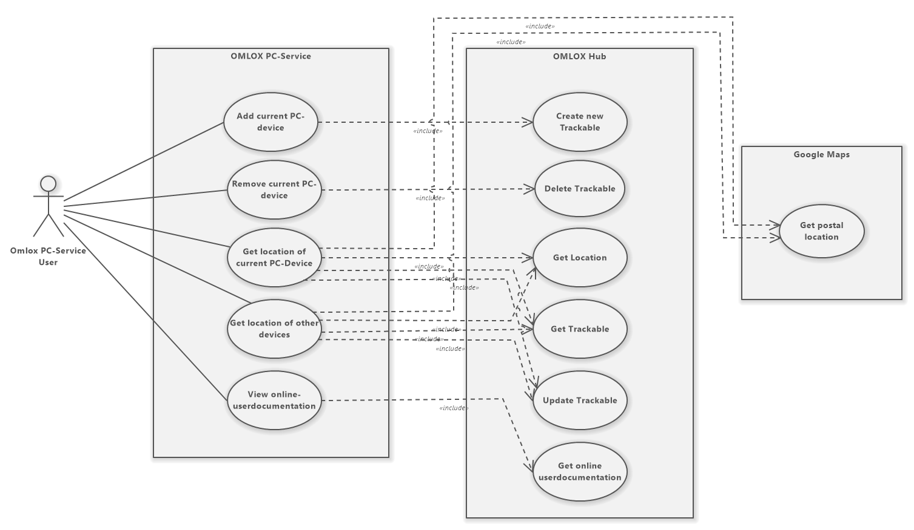
Master UseCase
Notes:
Systemumgebungen:
- Omlox PC Service
- Omlox HUB
- Google Maps

Slide 14
Master UseCase
UC.001 | ADD current PC-device to the OMLOX Hub
Use Case's Objective | User creates a new trackable in the OMLOX Hub. The new trackable is their currently used device
System Boundary | Omlox PC-Service, Omlox Hub
Precondition | User wants to add their current PC-device to the OMLOX-Hub
Postcondition on success | A new trackable gets added to the OMLOX Hub. The new trackable is the currently used PC-device
Involved Users | Each user of Omlox Hub that uses the PC-Service
Triggering Event | When user has not added their PC-device to the OMLOX Hub yet
UC.002 | REMOVE current PC-device to the OMLOX Hub
Use Case's Objective | A trackable gets deleted from the OMLOX Hub. The deleted trackable is the used PC-device
System Boundary | Omlox PC-Service, Omlox Hub
Precondition | User wants to remove their current PC-device from the OMLOX Hub
Postcondition on success | A trackable gets deleted from the OMLOX Hub
Involved Users | Each user of Omlox Hub that uses the PC-Service
Triggering Event | When user has the need to remove their PC-device from the OMLOX Hub
Notes:
UC1: benutztes PC-Gerät wird dem OmloxHub hinzugefügt
UC2: benutztes PC Gerät wird vom OmloxHUb entfernt

Slide 15
Master UseCase
UC.003 | Get location of current PC-device
Use Case's Objective | Getting the data of the location of the current used PC-device
System Boundary | Omlox PC-Service, Omlox Hub, Google Maps
Precondition | User needs to see the current location of their PC-device
Postcondition on success | The relevant data is displayed completely and correctly
Triggering Event | When user has the need to get the location data of their current used PC-device
Use Case's Objective | Getting the data of the location of the current used PC-device
UC.004 | Get location of other devices
Use Case's Objective | Getting the data of the location of a device from the Omlox Hub and/or Google Maps
System Boundary | Omlox PC-Service, Omlox Hub, Google Maps
Precondition | User needs to see the current location of other devices registered in the Omlox Hub
Postcondition on success | The relevant data is displayed completely and correctly
Involved Users | Each user of Omlox Hub that uses the PC-Service
Triggering Event | When user has the need to see the location data of another device in the Omlox Hub
Notes:
UC3: Es wird der Ort des PC-Geräts abgefragt
UC4: Es wird der Ort von anderen PC-Geräten abgefragt

Slide 16
Master UseCase
UC.005 | View userdocumentation
Use Case's Objective | After getting the Omlox PC-Service, users have access to userdocumentation
System Boundary | Omlox PC-Service, Omlox Hub
Precondition | User wants to see how a specific function works
Postcondition on success | The userdocumentation is displayed completely and correctly
Involved Users | Each user of Omlox Hub that uses the PC-Service
Triggering Event | When the user has the need to view userdocumentation for specific functions or for all available functions
Notes:
UC5: Möglichkeit die userdocumentation einzusehen

Slide 17
Omlox als PC-Dienst
Architekturübersicht
Eric Höfert

Slide 18
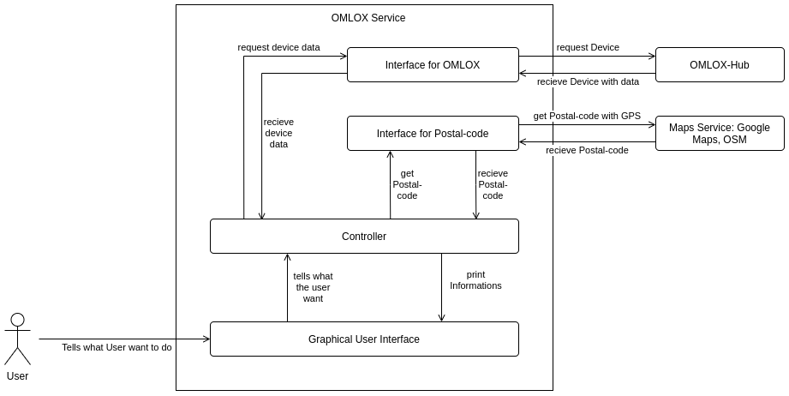
Systemarchitektur

Slide 19
Omlox als PC-Dienst
Testing
Aaron Kupries

Slide 20
Test Plan
ID | Functionality | Priority | Test Suite ID
LF10 | Adding/Removal of a device | A | TS.001
LF20 | Adding location | A | TS.002
LF30 | Updating new location to existing device | A | TS.003
LF40 | Show location on map | A | TS.004
LF50 | Show user-documentation | A | TS.005

Slide 21
Test Report
Test Suite ID | Functionality | Test Case ID | Status
TS.001 | Adding/Removal of a device | TC.001.001 | Passed
TS.002 | Adding location manually | TC.002.001 | Passed
 | Adding location automatically | TC.002.002 | Passed
TS.003 | Updating new location to existing device | TC.003.001 | Passed
TS.004 | Show location on map | TC.004.001 | Passed
TS.005 | Show user-documentation | TC.005.001 | Passed

Slide 22
Omlox als PC-Dienst
Live Demo
Samir Ahmetovic & Aaron Weis

Slide 23
Omlox als PC-Dienst
Fazit / Ausblick
Alle

Slide 24
Fazit / Ausblick
Ziel
Ausblick
OMLOX-Spezifikation (DeepHub API) PC-Lokalisierung Position anderer Geräte MS-Windows
Ziele
Erreicht
Mehrere Nutzer
Vor DeepHub geschalteter Server mit Nutzer-/ Loginverwaltung

